Slide 1
Graph Theory
Team:BIGRES

Slide 2
Team members
Ulzhanar Nurgazy
Meruyert Anarbay
Seniha Bekmez
Aisana Yessimkhan
Shamil Khamit

Slide 3
Graph theory
Graph theory is the mathematical study of systems of interacting elements. The elements are modeled as nodes in a graph, and their connections are represented as edges. These edges could represent physical (e.g., an axon between neurons) or statistical (e.g., a correlation between time-series) relationship.

Slide 4
A list of all the graph theory terms we need to know:
path - a sequence of edges connecting different (non-repeating) vertices;
routes are the same paths, only they do not require a sequence of different vertices;
cycle - a group of vertices linked together in a closed chain. In the picture above, the peaks [1,2,4] make up a cycle;
connected graph - a graph in which there is one path between any pair of vertices;
tree is a connected graph that does not contain a cycle;
undirected graph - a graph in which the edges have no direction. The figure above shows just an undirected graph. In such an undirected graph, you can move along an edge in either of two directions;
directed graph - a graph in which the edges have directions and are indicated by arrows. In such a directed graph, you can move along the edge only in the specified direction.

Slide 5
Graph theory
Graph Theory is ultimately the study of relationships. Given a set of nodes & connections, which can abstract anything from city layouts to computer data, graph theory provides a helpful tool to quantify & simplify the many moving parts of dynamic systems. Studying graphs through a framework provides answers to many arrangement, networking, optimization, matching and operational problems.
Graphs can be used to model many types of relations and processes in physical, biological, social and information systems, and has a wide range of useful applications such as e.g.
Finding communities in networks, such as social media (friend/connection recommendations), or in the recent days for possible spread of COVID19 in the community through contacts.
Ranking/ordering hyperlinks in search engines.
GPS/Google maps to find the shortest path home.
Study of molecules and atoms in chemistry.
DNA sequencing
Computer network security
….. and many more…

Slide 6
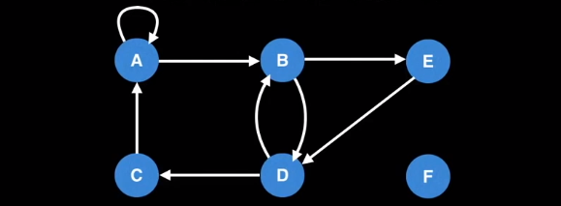
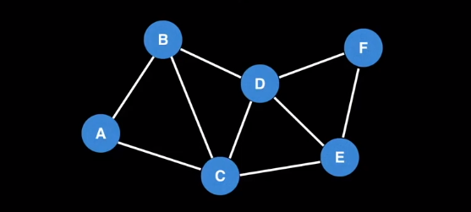
Graph Theory Algorithms
Directed graph
A graph with edges that have direction on them is called a directed graph. It may be used to show relations to predecessors (arrow from parents to their child) or ancestors (arrow from children to their parents).
Undirected graph
A graph with edges without directions on them is called an undirected graph. It may be used to show a two-way road.

Slide 7
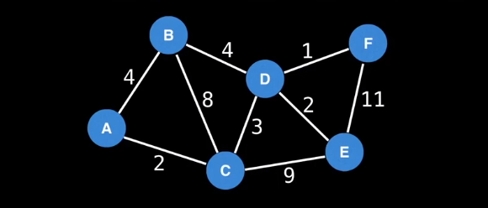
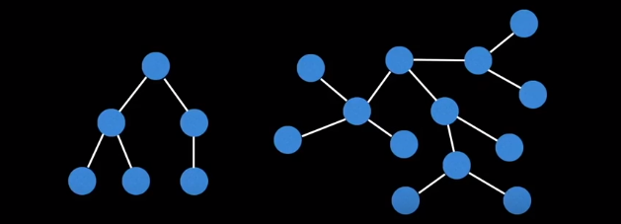
Weighted graph
A graph in which the edges have a number on them to represent the cost of a transaction, fair of a journey, the distance between cities, etc. It can have any type of edge.
Tree
An undirected graph with no cycles in it is a tree. Here, cycle means that there is only one way to go to a node by following edges from a given other node.
A tree has all its nodes connected by an edge to some other node and has N nodes with N-1 edges.

Slide 8
Application of given theory
Graph Theory is used in vast area of science and technologies. Some of them are given below:
1. Computer Science
In computer science graph theory is used for the study of algorithms like:
Dijkstra's Algorithm
Prims's Algorithm
Kruskal's Algorithm
Graphs are used to define the flow of computation.
Graphs are used to represent networks of communication.
Graphs are used to represent data organization.

Slide 9
2. Electrical Engineering
In Electrical Engineering, graph theory is used in designing of circuit connections. These circuit connections are named as topologies. Some topologies are series, bridge, star and parallel topologies.
3. Computer Network
In computer network, the relationships among interconnected computers within the network, follow the principles of graph theory.
Graph theory is also used in network security.
We can use the vertex coloring algorithm to find a proper coloring of the map with four colors.
Vertex coloring algorithm may be used for assigning at most four different frequencies for any GSM (Grouped Special Mobile) mobile phone networks.

Slide 10
4. Mathematics
In mathematics, operational research is the important field. Graph theory provides many useful applications in operational research. Like:
Minimum cost path.
A scheduling problem.
5. General
Graphs are used to represent the routes between the cities. With the help of tree that is a type of graph, we can create hierarchical ordered information such as family tree.

